Slide 1
Self-organizing Maps
Kevin Pang

Slide 2
Goal
Research SOMs
Create an introductory tutorial on the algorithm
Advantages / disadvantages
Current applications
Demo program

Slide 3
Self-organizing Maps
Unsupervised learning neural network
Maps multidimensional data onto a 2 dimensional grid
Geometric relationships between image points indicate similarity

Slide 4
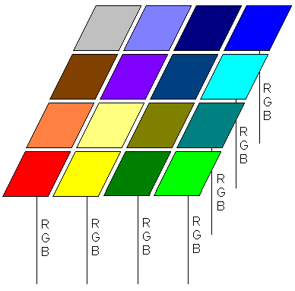
Algorithm
Neurons arranged in a 2 dimensional grid
Each neuron contains a weight vector
  Example: RGB values

Slide 5
Algorithm (continued…)
Initialize weights
  Random
  Pregenerated
Iterate through inputs
For each input, find the “winning” neuron
  Euclidean distance
Adjust “winning” neuron and its neighbors
  Gaussian
  Mexican hat

Slide 6
Optimization Techniques
Reducing input / neuron dimensionality
  Random Projection method
Pregenerating neuron weights
  Initialize map closer to final state
Restricting “winning” neuron search
  Reduce the amount of exhaustive searches

Slide 7
Conclusions
Advantages
  Data mapping is easily interpreted
  Capable of organizing large, complex data sets
Disadvantages
  Difficult to determine what input weights to use
  Mapping can result in divided clusters
  Requires that nearby points behave similarly

Slide 8
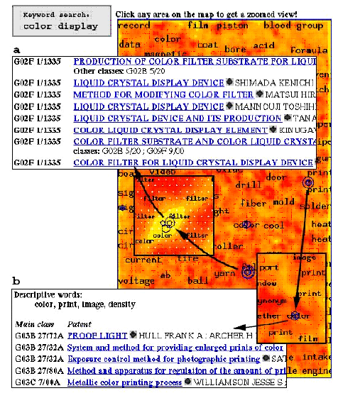
Current Applications
WEBSOM: Organization of a Massive Document Collection

Slide 9
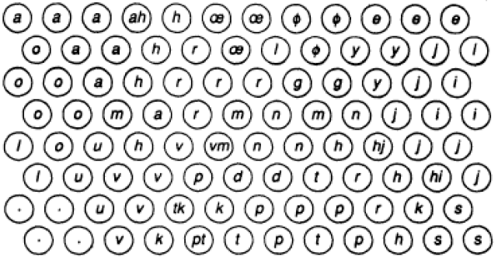
Current Applications (continued)
Phonetic Typewriter

Slide 10
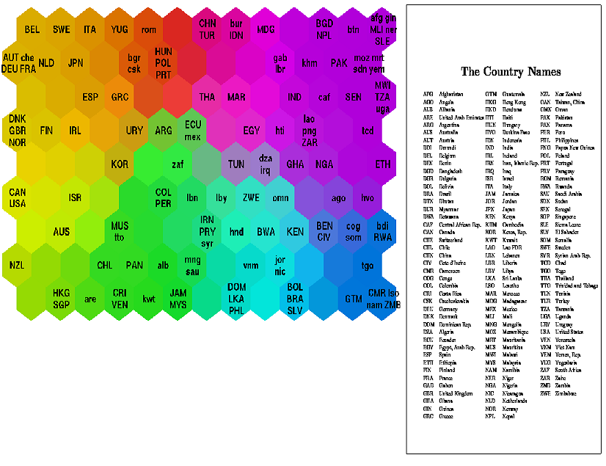
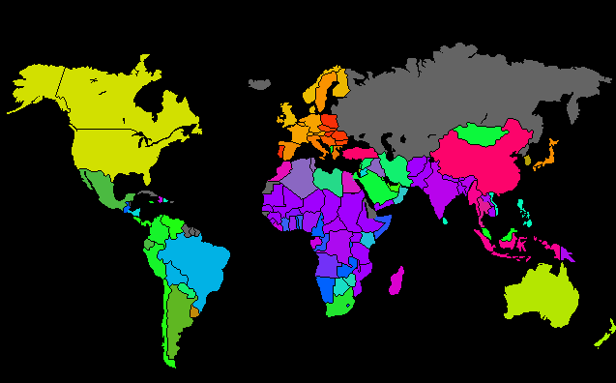
Current Applications (continued)
Classifying World Poverty

Slide 11
Demo Program
Written for Windows with GLUT support
Demonstrates the SOM training algorithm in action

Slide 12
Demo Program Details
Randomly initialized map
100 x 100 grid of neurons, each containing a 3-dimensional weight vector representing its RGB value
Training input randomly selected from 48 unique colors
Gaussian neighborhood function

Slide 13
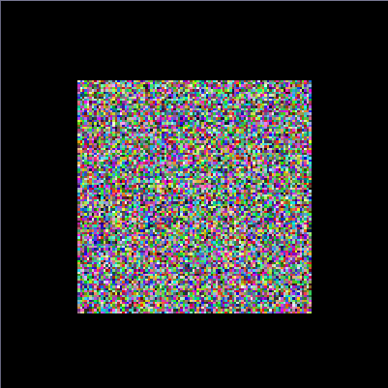





Screenshots

Slide 14
Questions?

